Slide 1
MCDA 5550 - Web App Development Chapter 9. Using mongoDB server for sharing and storing information (Part 1)
Instructor: DINESH KG

Slide 2
NoSQL Database
Stored in a “collection” (as opposed to tables of “relational” DBs e.g. MySQL)
“with the proliferation of text, images, videos (i.e., unstructured data) flowing through the information grid, the relational database model not always best option”

Slide 3
mongoDB
One of the most popular implementation of NoSQL databases
A collection consists of
{key/name : value}
(as in JSON objects)
Installed on dev.cs.smu.ca

Slide 4
User/password
User ID/Password: the same as your login ID (and password is your A-number) for dev.cs.smu.ca
GUI Support is available, but here we need to use CLI (command line interface)

Slide 5
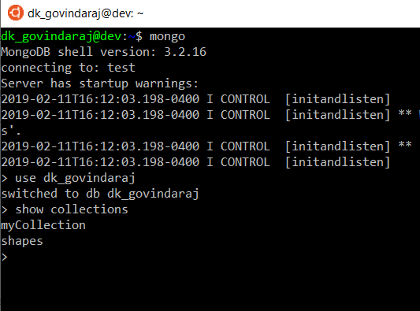
Starting mongoDB

Slide 6
“use” command
> use name_of_your_db
Switches between databases
You have been assigned your own database that has the same name as your ID
e.g.) if my id is “dk_govindaraj” my database name is also “dk_govindaraj”

Slide 7
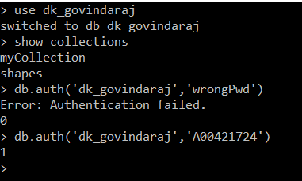
db.auth() command
db.auth(‘user_name',‘password’) Authorizes the user to access collections in the current database Without successful db.auth(), you can’t read/write collections
Failure (returned 0)
Success
(returned 1)

Slide 8
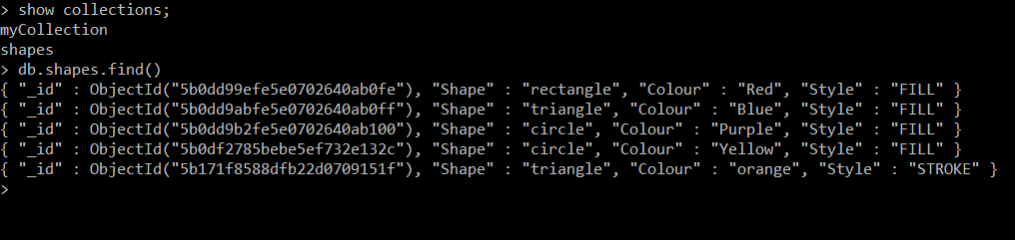
Collections
A collection contains documents
Collections to be analogous to tables and documents to be analogous to records
e.g.) A collection “rectangles”

Slide 9
Operations with collections
show collections
List all the collections of the current db
db.createCollection(collection_name)
db.collectionName.insert()
Add new documents (or create a new collection if not existing)
db.collectionName.find(key)
Find matching document(s)

Slide 10
Operations with collections
db.collectionName.remove(key)
Delete matching document(s)
db.collectionName.drop()
Delete the entire collection

Slide 11
Complex objects
We can store documents of more complex (JSON) objects in mongoDB
Diversion from the first normal form (1NF) in relational databases
i.e.) an attribute can only store one atomic value.

Slide 12
In relational DB
In the standard relational DB, if a student (“Dinesh”) has taken 3 courses, to store this information, we’ll typically need 3 separate records:
“name” = “Dinesh” and “course”=“CSCI1226”
“name” = “Dinesh” and “course”=“CSCI1227”
“name” = “Dinesh” and “course”=“CSCI1228”

Slide 13
In mongoDB
{
“name “ : “Dinesh”,
“courses “ :
[
{“acronym”: “CSCI1226”, “year” : 2001 },
{“acronym”: “CSCI1227”, “year” : 2001 },
{“acronym”: “CSCI1228”, “year” : 2002 }
]
}

Slide 14
students collection
[
{
"name" : “Dinesh",
"courses" :
[
{"acronym": "CSCI1226", "year" : 2001 },
{"acronym": "CSCI1227", "year" : 2001 },
{"acronym": "CSCI1228", "year" : 2002 }
]
}
,
{
"name" : “Joe",
"courses" :
[
{"acronym": "CSCI2356", "year" : 2002 },
{"acronym": "CSCI3412", "year" : 2003 },
]
}
]

Slide 15
Search a document (a JSON object)
> db.students.find({name:“Dinesh"})
{ "_id" : ObjectId("56e981b8de44f2b53f508aea"), "name" : “Dinesh", "courses " : [ { "acronym" : "CSCI1226", "year" : 2001 }, { "acronym" : "CSCI1227", "year" : 2001 }, { "acronym" : "CSCI1228", "year" : 2002 } ] }
> db.students.find( {courses:{"acronym": "CSCI1226", "year" : 2001 } } )
{ "_id" : ObjectId("56e9833eca77c82ea10067be"), "name" : “Dinesh", "courses" : [ { "acronym" : "CSCI1226", "year" : 2001 }, { "acronym" : "CSCI1227", "year" : 2001 }, { "acronym" : "CSCI1228", "year" : 2002 } ] }

Slide 16
Update a document (push)
> db.students.update({
... name:“Dinesh"},
... {$push:{courses:{acronym:"CSCI2356",year:2003}}}
... )
WriteResult({ "nMatched" : 1, "nUpserted" : 0, "nModified" : 1 })
> db.students.find({name:“Dinesh"})
{ "_id" : ObjectId("56e9833eca77c82ea10067be"), "name" : “Dinesh", "courses" : [ { "acronym" : "CSCI1226", "year" : 2001 }, { "acronym" : "CSCI1227", "year" : 2001 }, { "acronym" : "CSCI1228", "year" : 2002 }, { "acronym" : "CSCI2356", "year" : 2003 } ] }

Slide 17
Update a document (pop)
> db.students.update({ name:“Dinesh"}, {$pop:{courses:{acronym:"CSCI2356",year:2003}}} )
WriteResult({ "nMatched" : 1, "nUpserted" : 0, "nModified" : 1 })
> db.students.find({name:“Dinesh"})
{ "_id" : ObjectId("56e9833eca77c82ea10067be"), "name" : “Dinesh", "courses" : [ { "acronym" : "CSCI1226", "year" : 2001 }, { "acronym" : "CSCI1227", "year" : 2001 }, { "acronym" : "CSCI1228", "year" : 2002 } ] }

Slide 18
Update a document (set)
> db.students.find({name:“Dinesh"})
{ "_id" : ObjectId("56f004bf040ccb8e57b87c66"), "name" : “Dinesh", "courses" : [ { "acronym" : "CSCI1226", "year" : 2001 }, { "acronym" : "CSCI1227", "year" : 2001 }, { "acronym" : "CSCI1228", "year" : 2002 } ] }
> db.students.update({name:" Dinesh "},{$set: {name:"Dinesh KG"}})
WriteResult({ "nMatched" : 1, "nUpserted" : 0, "nModified" : 1 })
> db.students.find({name:“Dinesh"})
> db.students.find({name:“Dinesh KG"})
{ "_id" : ObjectId("56f004bf040ccb8e57b87c66"), "name" : "Dinesh KG", "courses" : [ { "acronym" : "CSCI1226", "year" : 2001 }, { "acronym" : "CSCI1227", "year" : 2001 }, { "acronym" : "CSCI1228", "year" : 2002 } ] }

Slide 19
Activity
Create a collection called universities
Each document has the 3 attributes (you know what they are by now!!!)
Insert several records
Try out other commands (remove, find, drop, etc)
> db.universities.find()
{ "_id" : ObjectId("56f0068d040ccb8e57b87c72"), "Name" : "SMU", "Address" : "923 Robie Street", "PhoneNumber" : "1-902-420-5400" }
{ "_id" : ObjectId("56f0068d040ccb8e57b87c73"), "Name" : "MSVU", "Address" : "166 Bedford Hwy", "PhoneNumber" : "1-902-457-6788" }
{ "_id" : ObjectId("56f0068d040ccb8e57b87c74"), "Name" : "DAL", "Address" : "6299 South S", "PhoneNumber" : "1-902-494-2211" }

Slide 20
Activity
Create a collection called rectangles
It’ll store x-y coordinates as well as the sizes (w, h) of rectangles
In the next section, we’ll write a program that reads these rectangles and draws on screen!
> db.rectangles.find()
{ "_id" : ObjectId("56f00609040ccb8e57b87c6d"), "x" : "1", "y" : "1", "w" : "25", "h" : "10", "c" : "red" }
{ "_id" : ObjectId("56f00609040ccb8e57b87c6e"), "x" : "3", "y" : "100", "w" : "50", "h" : "25", "c" : "yellow" }
{ "_id" : ObjectId("56f00609040ccb8e57b87c6f"), "x" : "15", "y" : "50", "w" : "40", "h" : "45", "c" : "green" }
{ "_id" : ObjectId("56f00609040ccb8e57b87c70"), "x" : "200", "y" : "20", "w" : "30", "h" : "75", "c" : "pink" }
{ "_id" : ObjectId("56f00609040ccb8e57b87c71"), "x" : "350", "y" : "350", "w" : "25", "h" : "95", "c" : "purple" }

